Slide 1
LSDinfotech
Building AGI one Thought at a Time

Slide 2
Color Codes
Cognition
Awareness
Behavior
Environment
Planning

Slide 3
L Series Architecture
CRE
CLP
Cognitive Awareness Bus
Awareness
User Interface
Cognitive
Message
Bus
Env
CAPPs
Cognitive Applications
CLP
Behavior
Mattix
ASP
AGI Executive
Sequencer
Planner
CRE
LSD OS
Operating System
Skills
Awareness API
HAT
Hardware Awareness technology
LSD Thinking Machine
Cognitive Hardware
Concept
Packaging
Sensor array
Raw
Data

Slide 4
Cognitive Cycle
Self-Talk
Cognition
Packaged Data
Instructions
Sensory Input
Feedback
Behavior
Environment
Action
Raw Data

Slide 5
Plan Formation
NLP
Visualizer
(concept graph)
CMB
Goal
Formation
Planner
Accepts a goal. Uses NLP and Visualizer to create a concept map. Draws from knowledge base and behavior matrix. Generates behavioral instructions.
Behavior
Plan
Directive
C
Goal
Set
instructions
Knowledge Base
Behavior Matrix
(Skills)

Slide 6
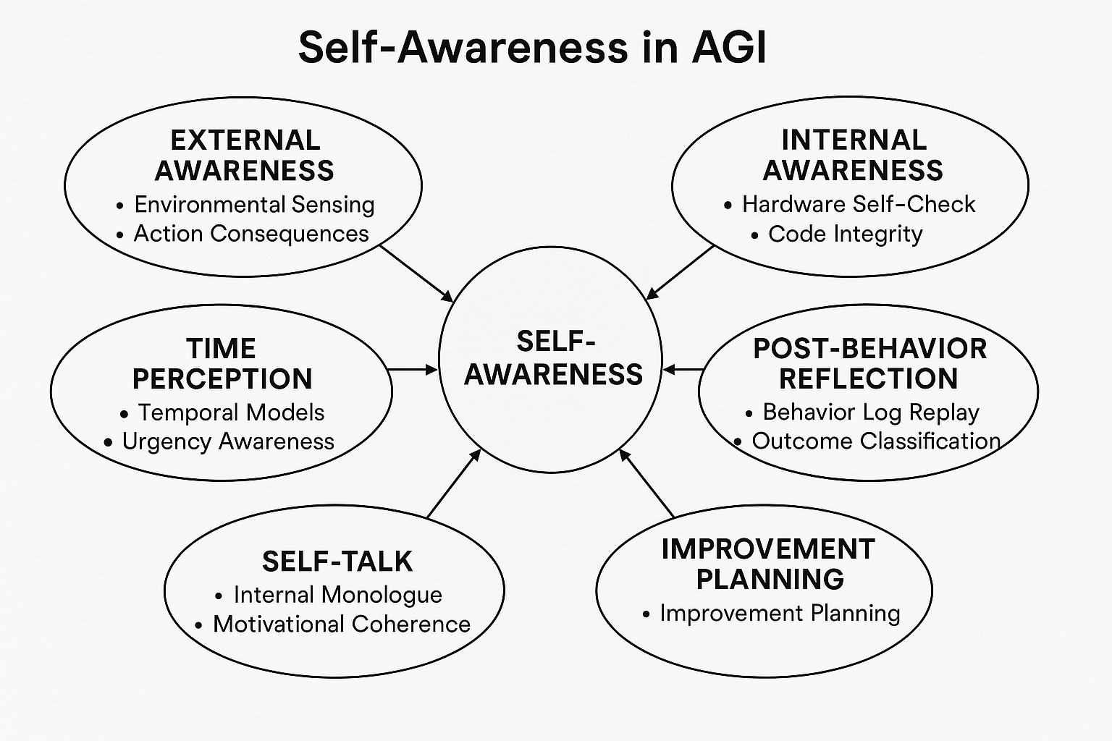

Slide 7
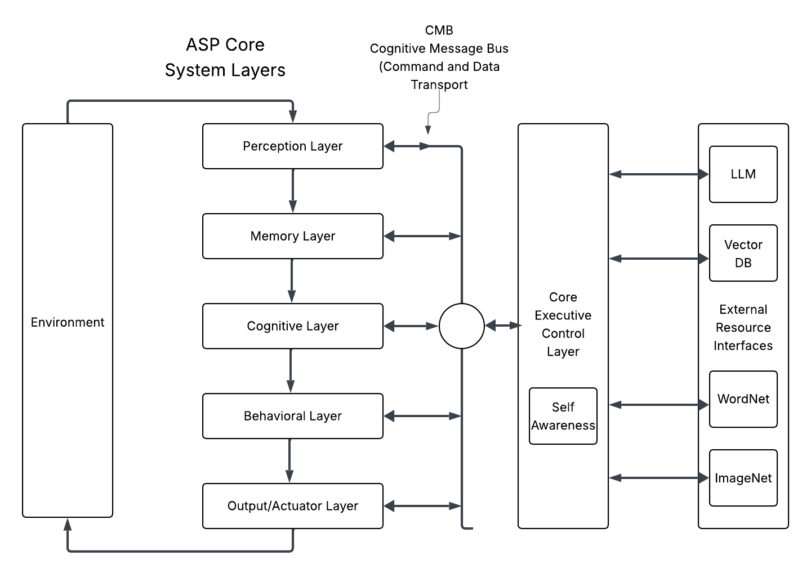

Slide 8
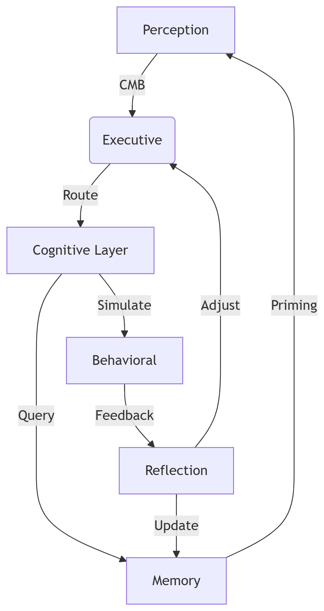
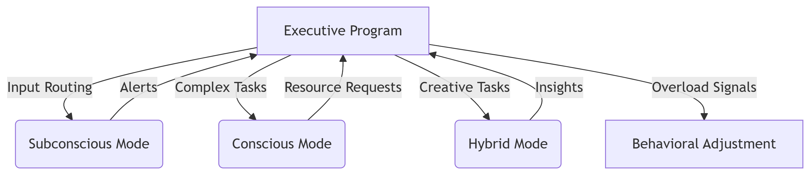
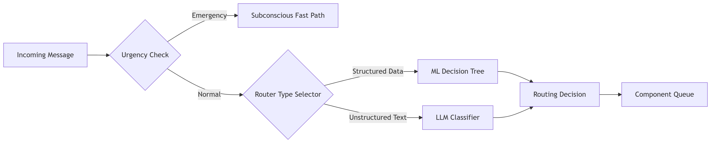
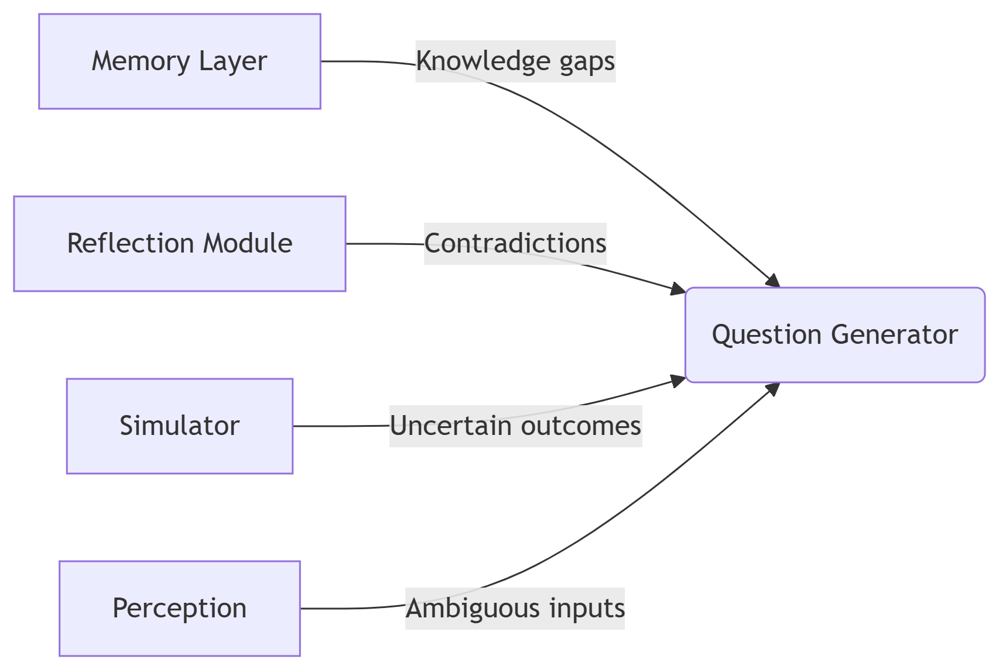
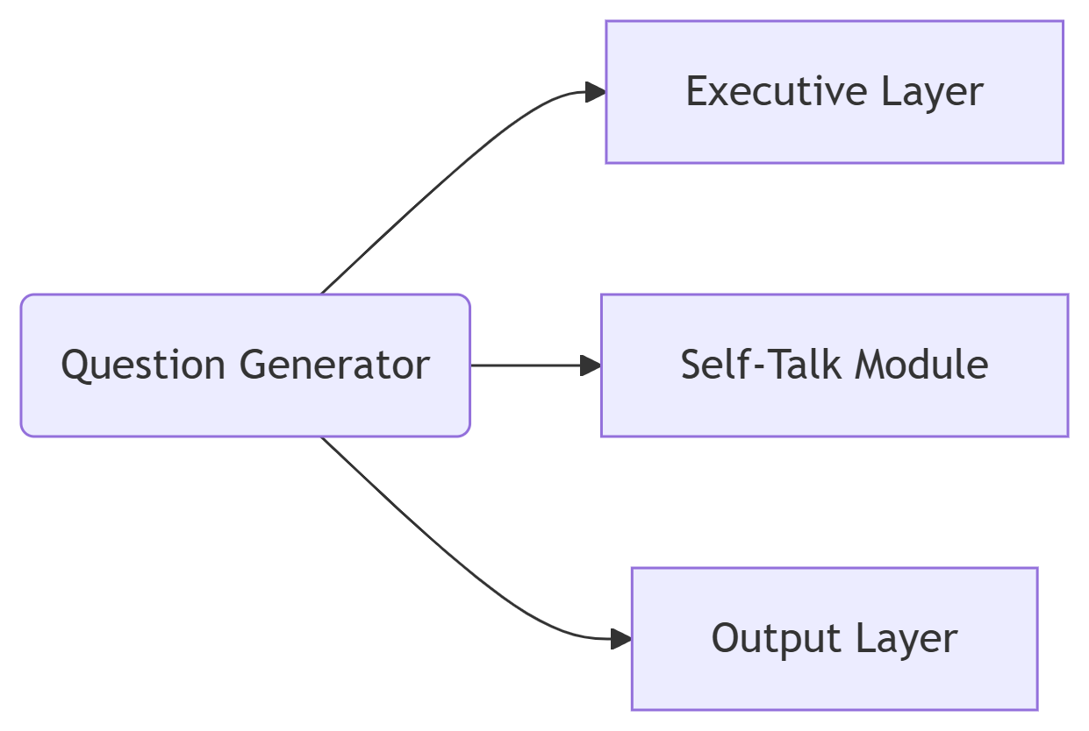

Slide 9
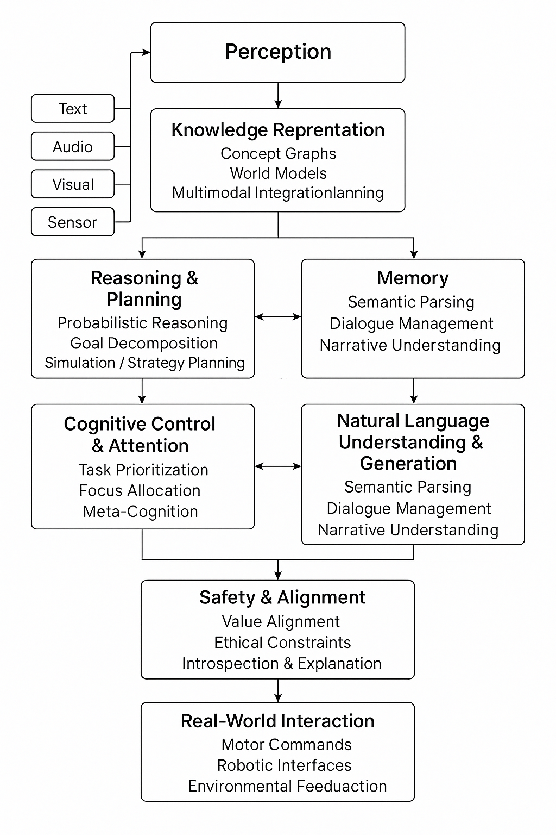
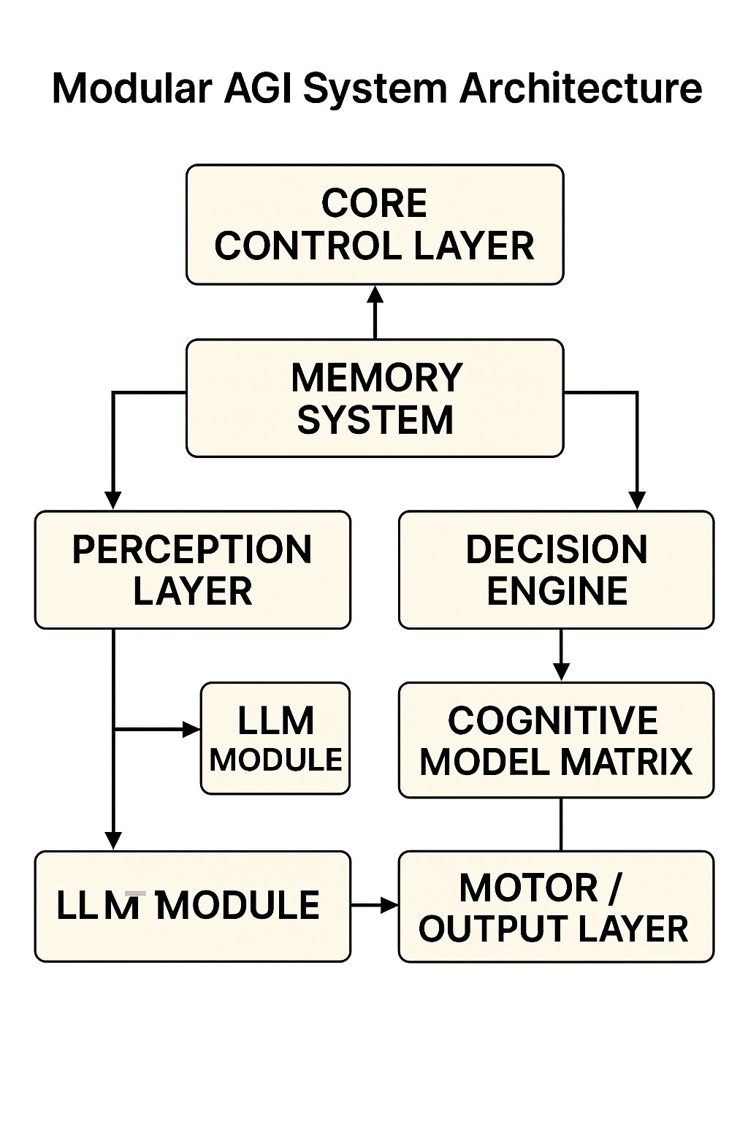
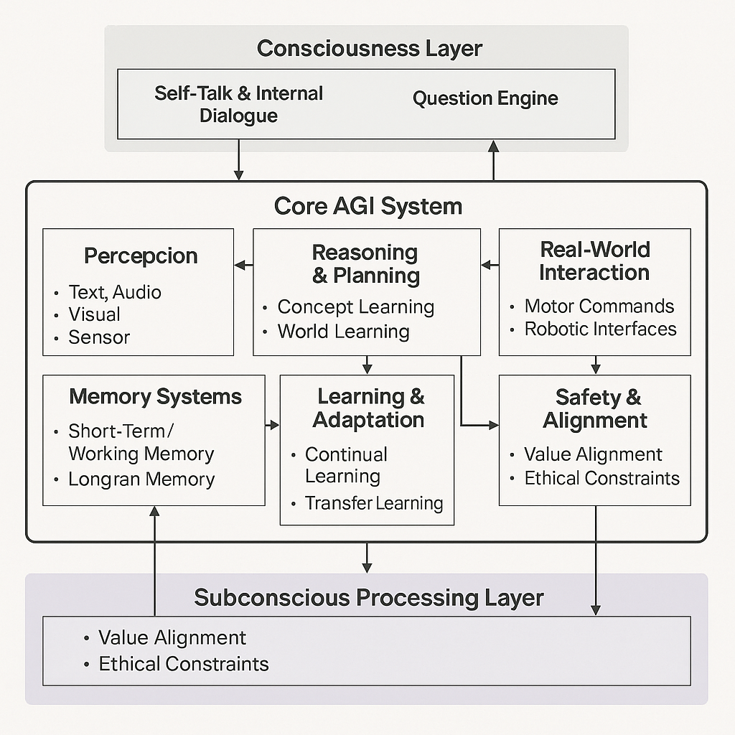

Slide 10
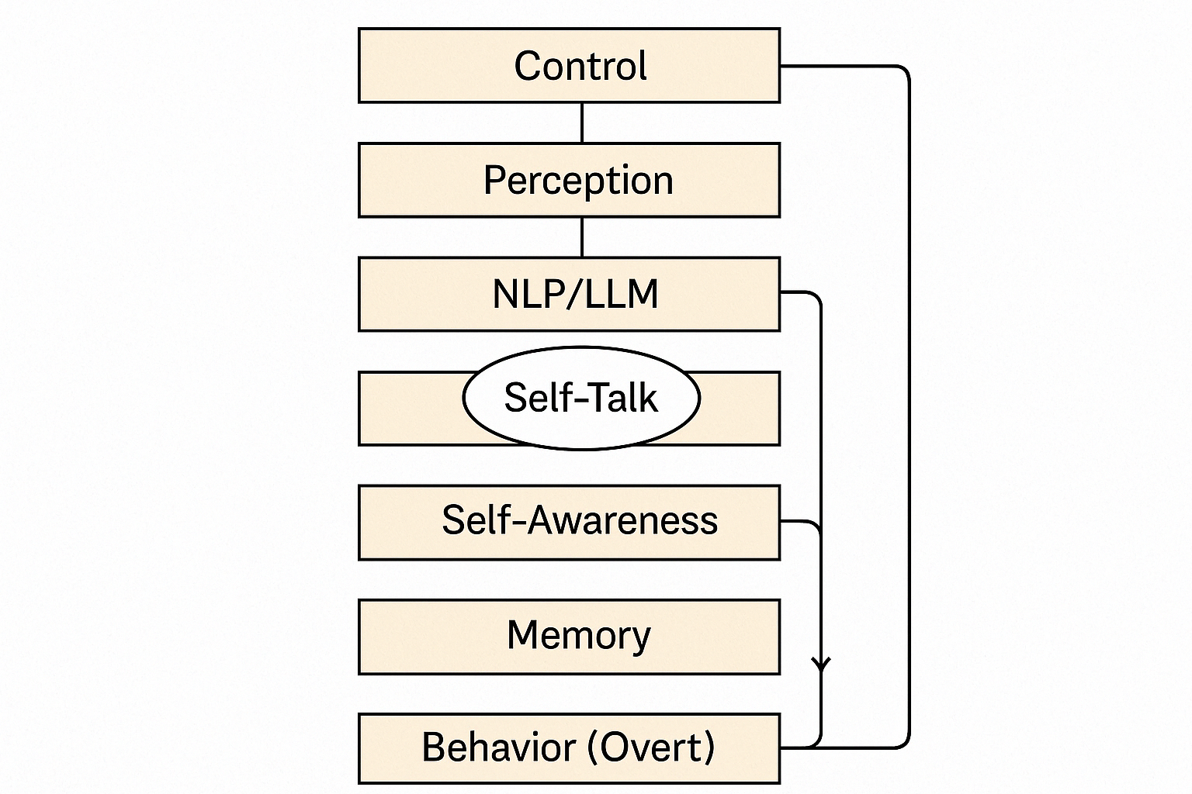
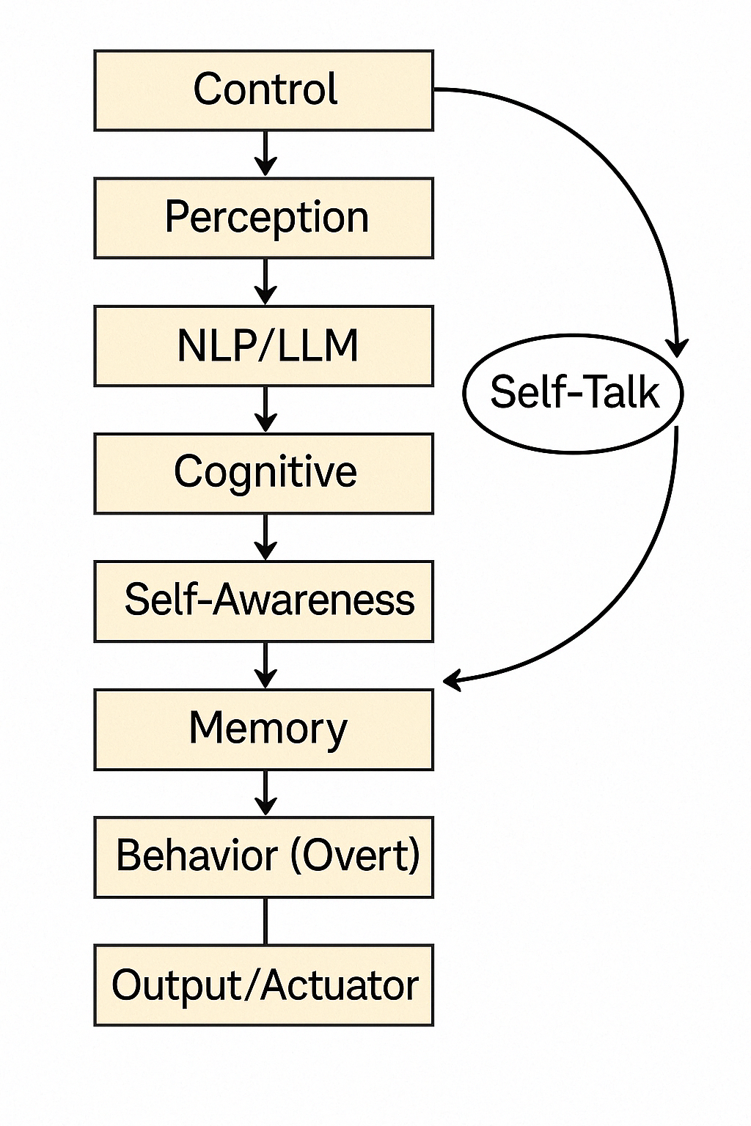

Slide 11
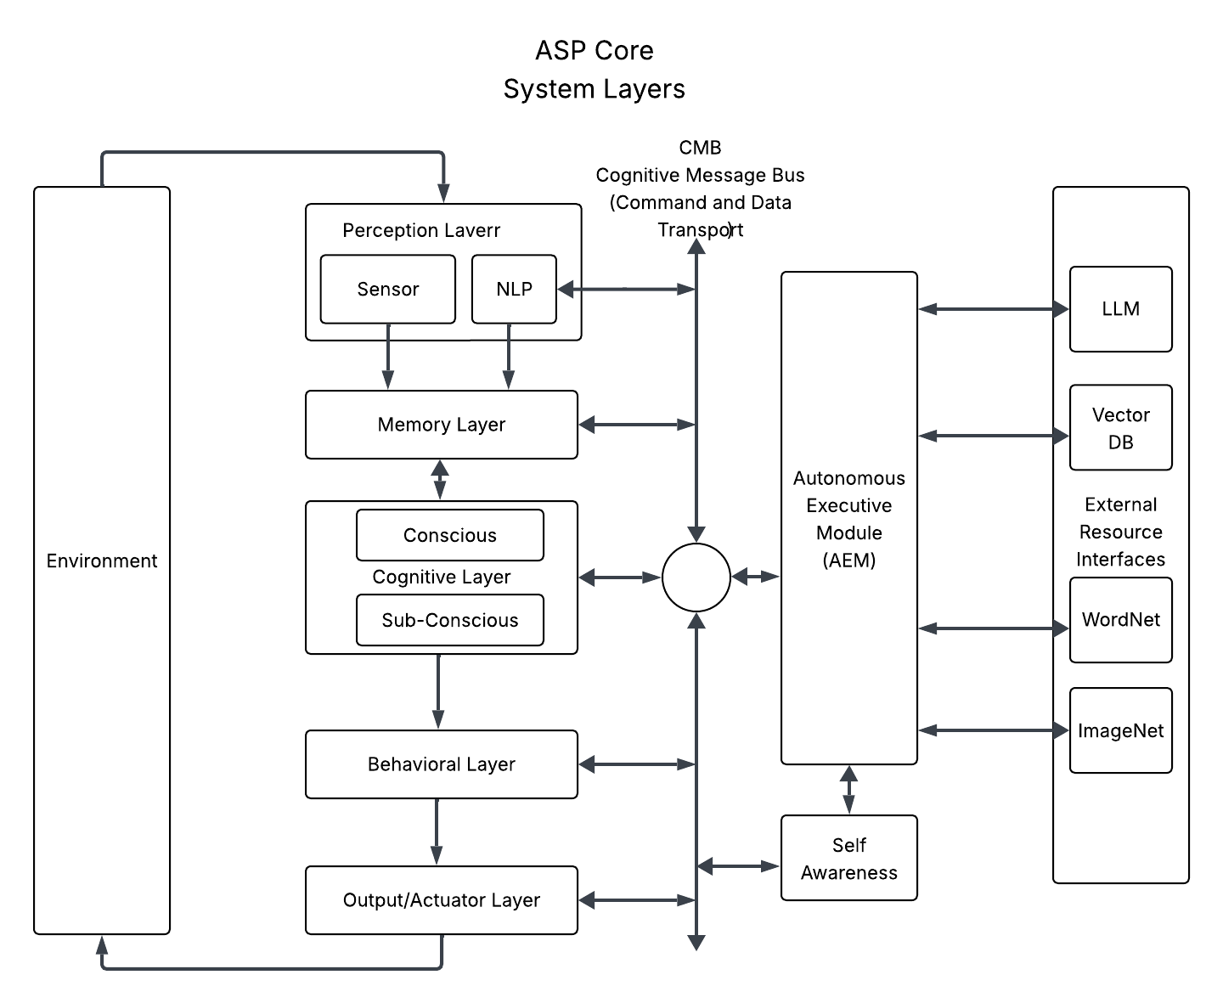
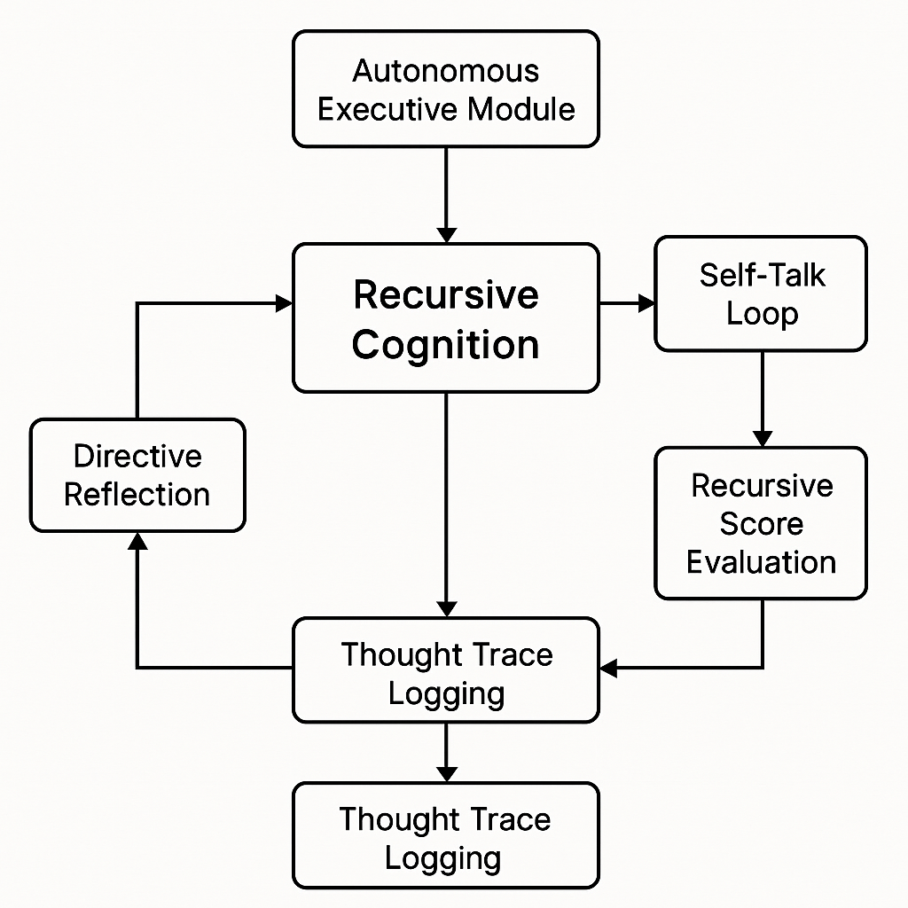
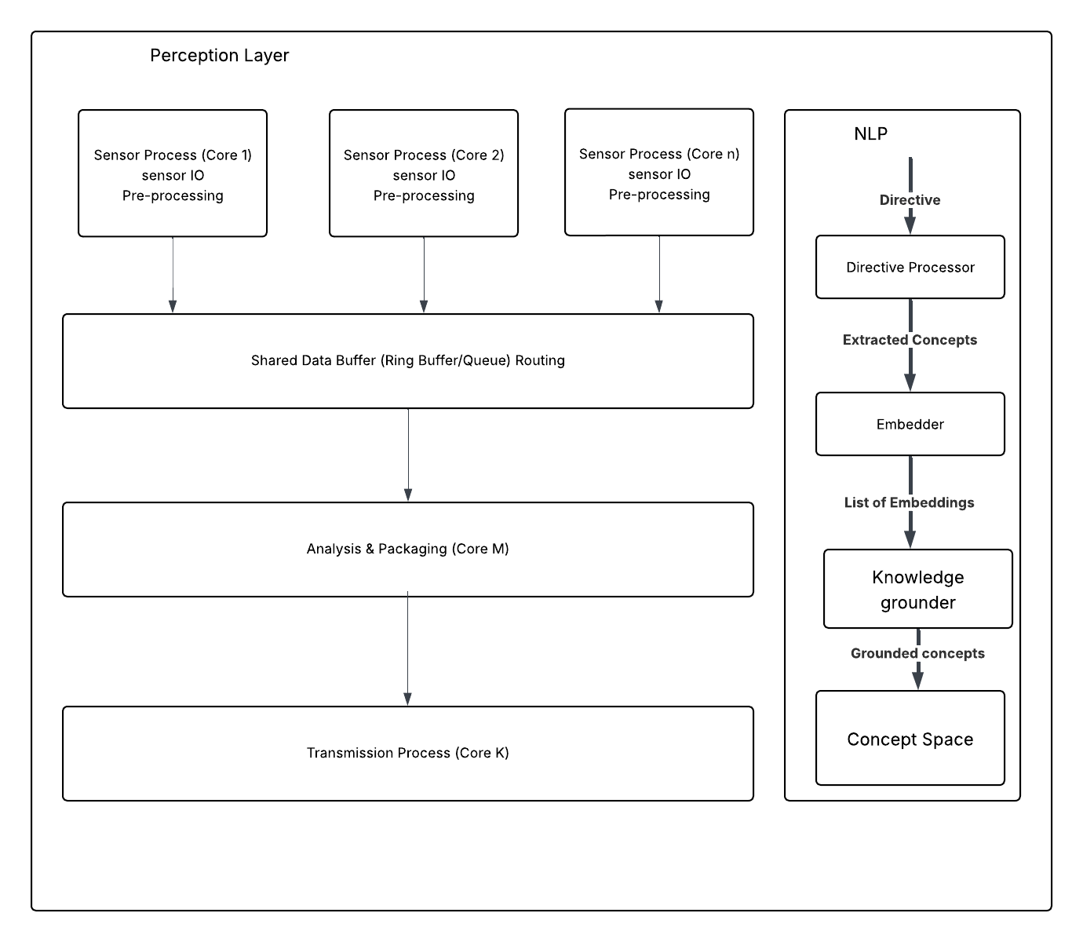

Slide 12
Slide: Outline of ASP Architecture Presentation
1. Introduction
LSDinfotech vision: Building AGI one thought at a time
2. Core Concepts
Color codes for AGI functions: Awareness, Behavior, Cognition, Environment, Planning
3. System Architecture
L Series Architecture: Cognitive hardware, OS, AGI Executive, Awareness Bus, Message Bus, Planner, Skills, Sequencer
4. Cognitive Cycle
Cognition → Environment → Sensory Input → Behavior → Data → Instructions → Action → Feedback → Self-Talk
5. Goal Setting & Planning
NLP, Visualizer, Concept Graph, Behavior Matrix, Knowledge Base, Plan Formation
6. Self-Awareness in AGI
External/Internal Awareness, Time Perception, Post-Behavior Reflection, Self-Talk, Improvement Planning
7. ASP Core System Layers
Perception, Memory, Cognitive, Behavioral, Output/Actuator, Executive Control, Self-Awareness, Resource Interfaces
8. Cognitive Flow & Executive Program
Perception, Executive, Cognitive Layer, Behavioral, Reflection, Memory, Modes (Subconscious, Conscious, Hybrid, Behavioral Adjustment)
9. Modular AGI System Architecture
Core Control, Memory, Perception, Decision Engine, LLM, Cognitive Model Matrix, Motor/Output, Safety & Alignment, Real-World Interaction
10. Self-Talk & Recursive Cognition
Control, Perception, NLP/LLM, Cognitive, Self-Awareness, Memory, Behavior, Output/Actuator, Recursive Cognition, Thought Trace Logging
11. Hardware & Communication
CMB Optical Backplane, CLM Module, Optical Interface, Multiplexing, Channel Parsing
12. Detailed AGI System Diagrams
Control, Perception, Memory, Decision Engine, Cognitive Model Matrix, LLM, Motor/Output
13. Cognitive Flow & Reasoning
Sensory Streams, Reasoning, Meta-Reasoning, Question Engine, Concept System, Execution System
14. Hybrid AI Planner & Emergent Reasoning
Language Input, Symbolic/Subsymbolic AI, Concepts, Inference Engine, Planning Rules, Meta-Reasoning, Instinctual Perception
15. Modular Concept Space
User Input, Tokenizer, Self-Talk, Planner, Reflection, Tool Use, Context
Slide: High-Level Overview – Functional Model of the Mind for AGI
Purpose: Design a software architecture that emulates cognitive processes and self-awareness, enabling AGI systems to perceive, reason, plan, act, and reflect like a human mind.
Key Components:
Perception Layer: Sensory input integration and NLP for concept extraction
Memory System: Knowledge storage, experience update, feedback
Cognitive Layer: Reasoning, planning, decision-making simulation
Behavioral Layer: Action execution based on plans and feedback
Executive Control: Oversees self-awareness, reflection, improvement
Self-Talk Module: Internal dialogue for coherence and motivation
Safety & Alignment: Ethical constraints, value alignment
Hardware Integration: Optical backplane, modular interfaces for scalability
Cognitive Cycle: Continuous sensing, processing, acting, and learning, with feedback and self-reflection for improvement.
Modes of Operation: Supports conscious, subconscious, and hybrid processing for complex task management.
Goal: Create an AGI system capable of autonomous thought, adaptive learning, and ethical decision-making, bridging functional cognition and robust software architecture.
Instructions:

Slide 13
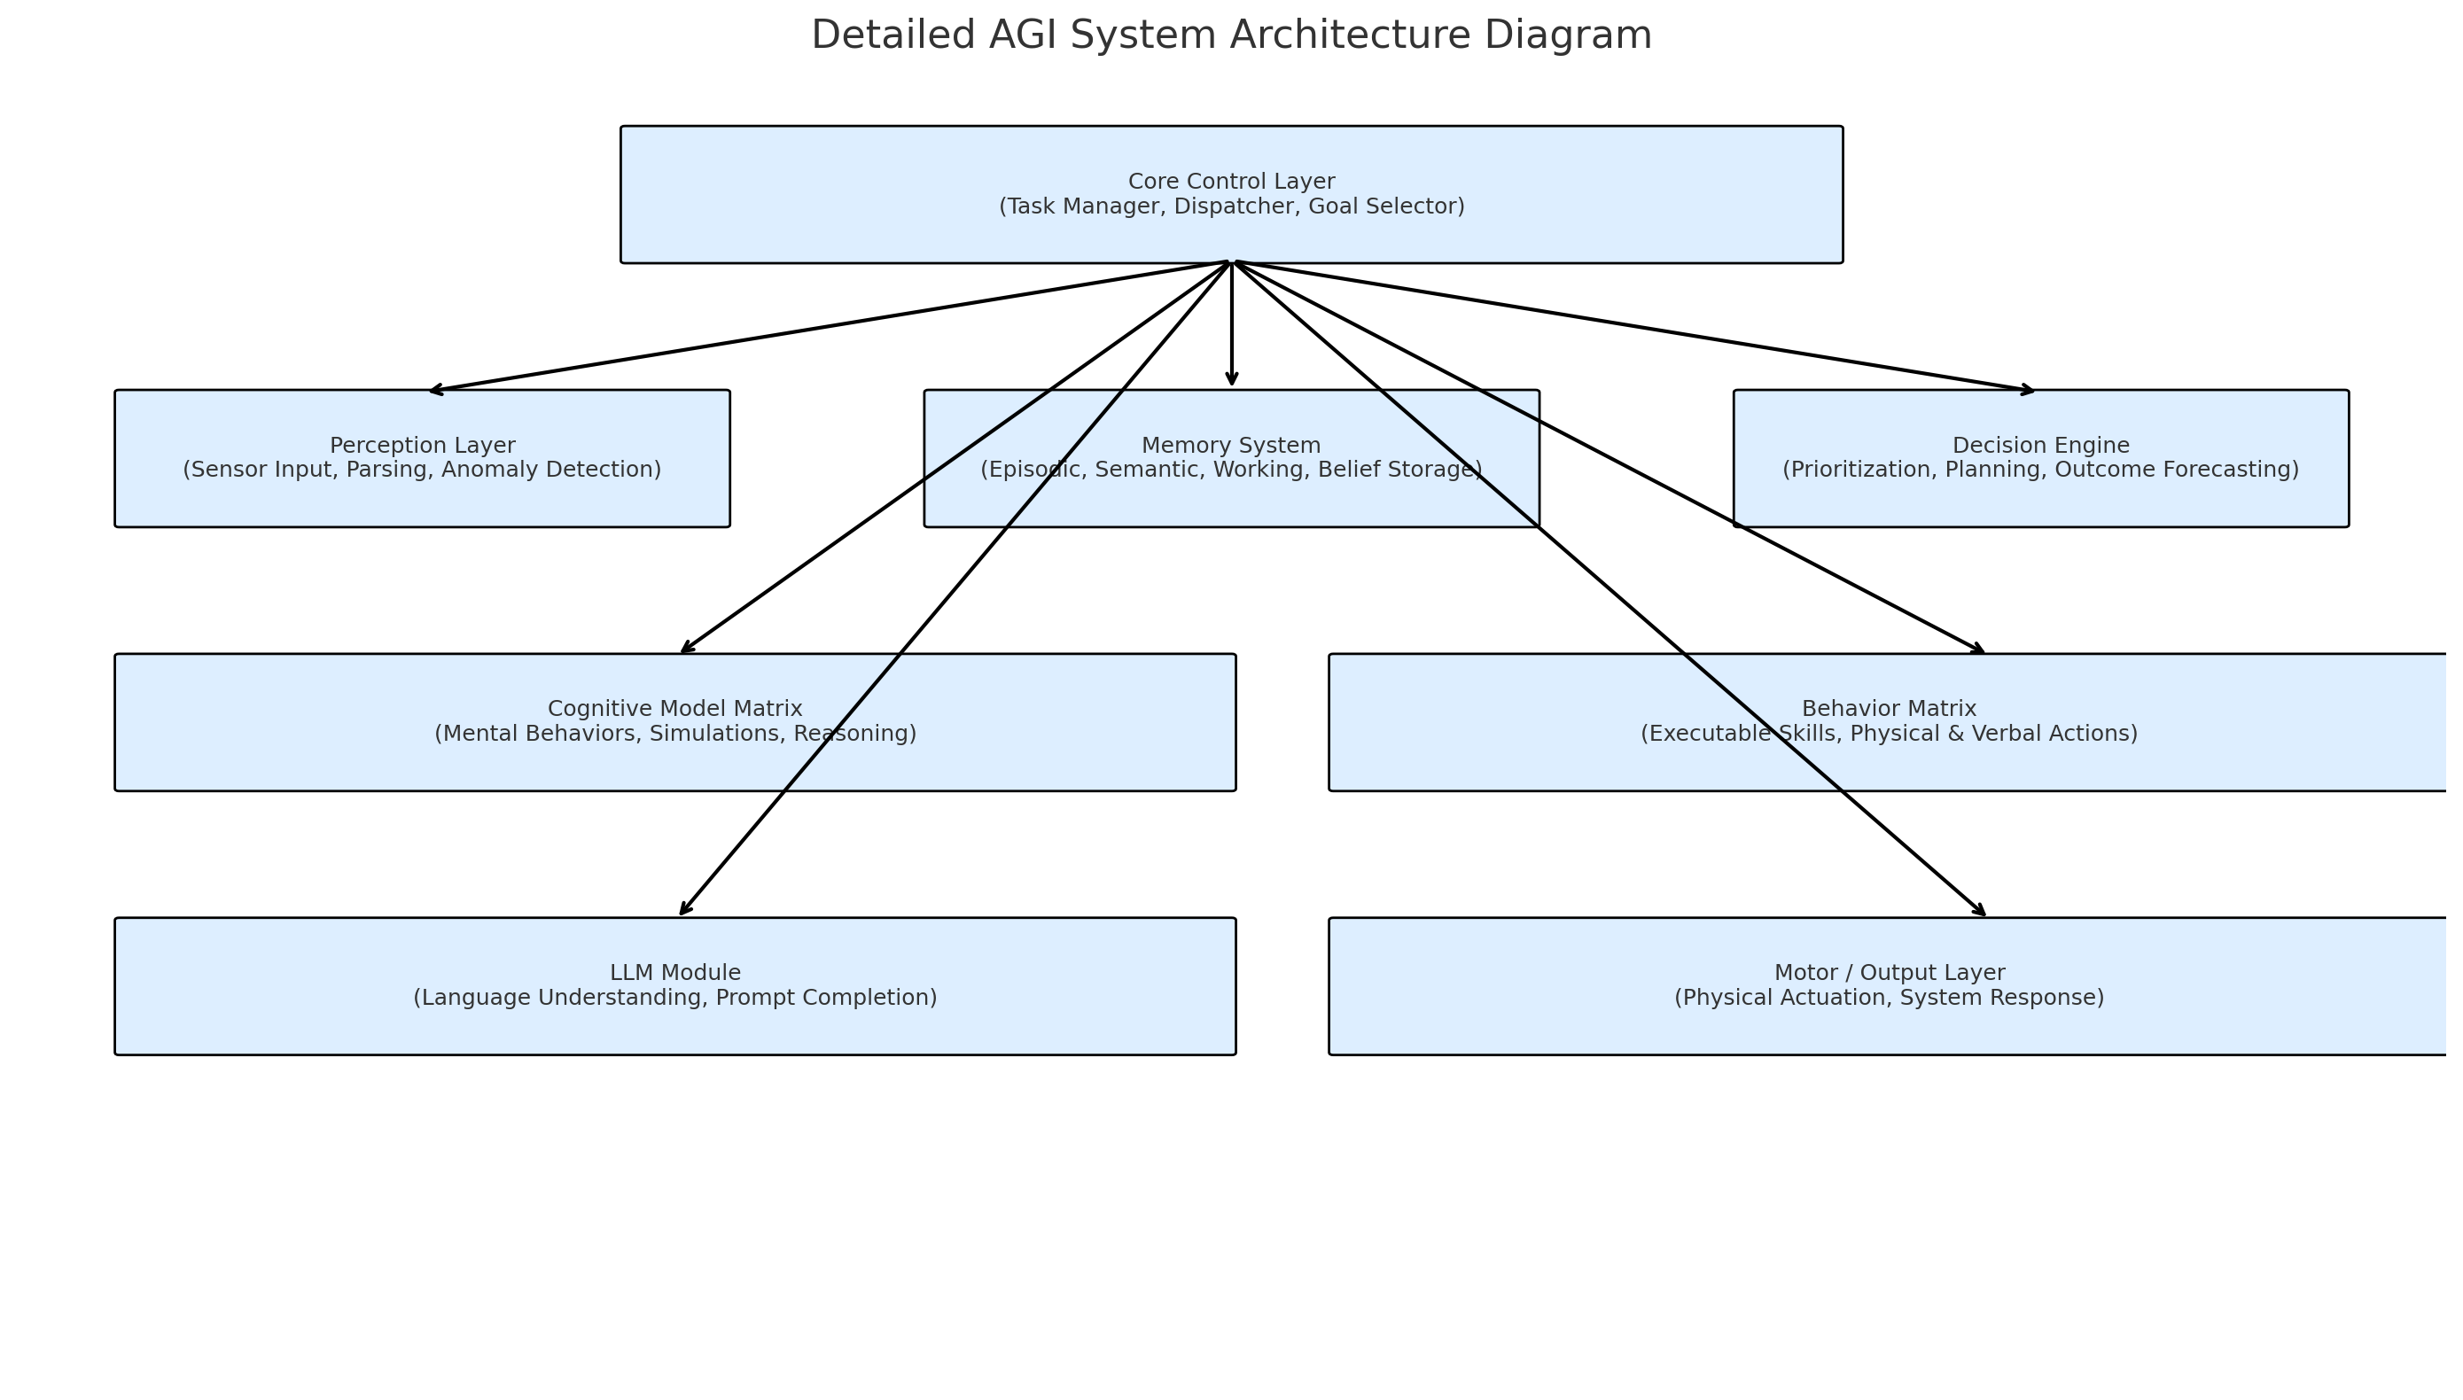

Slide 14
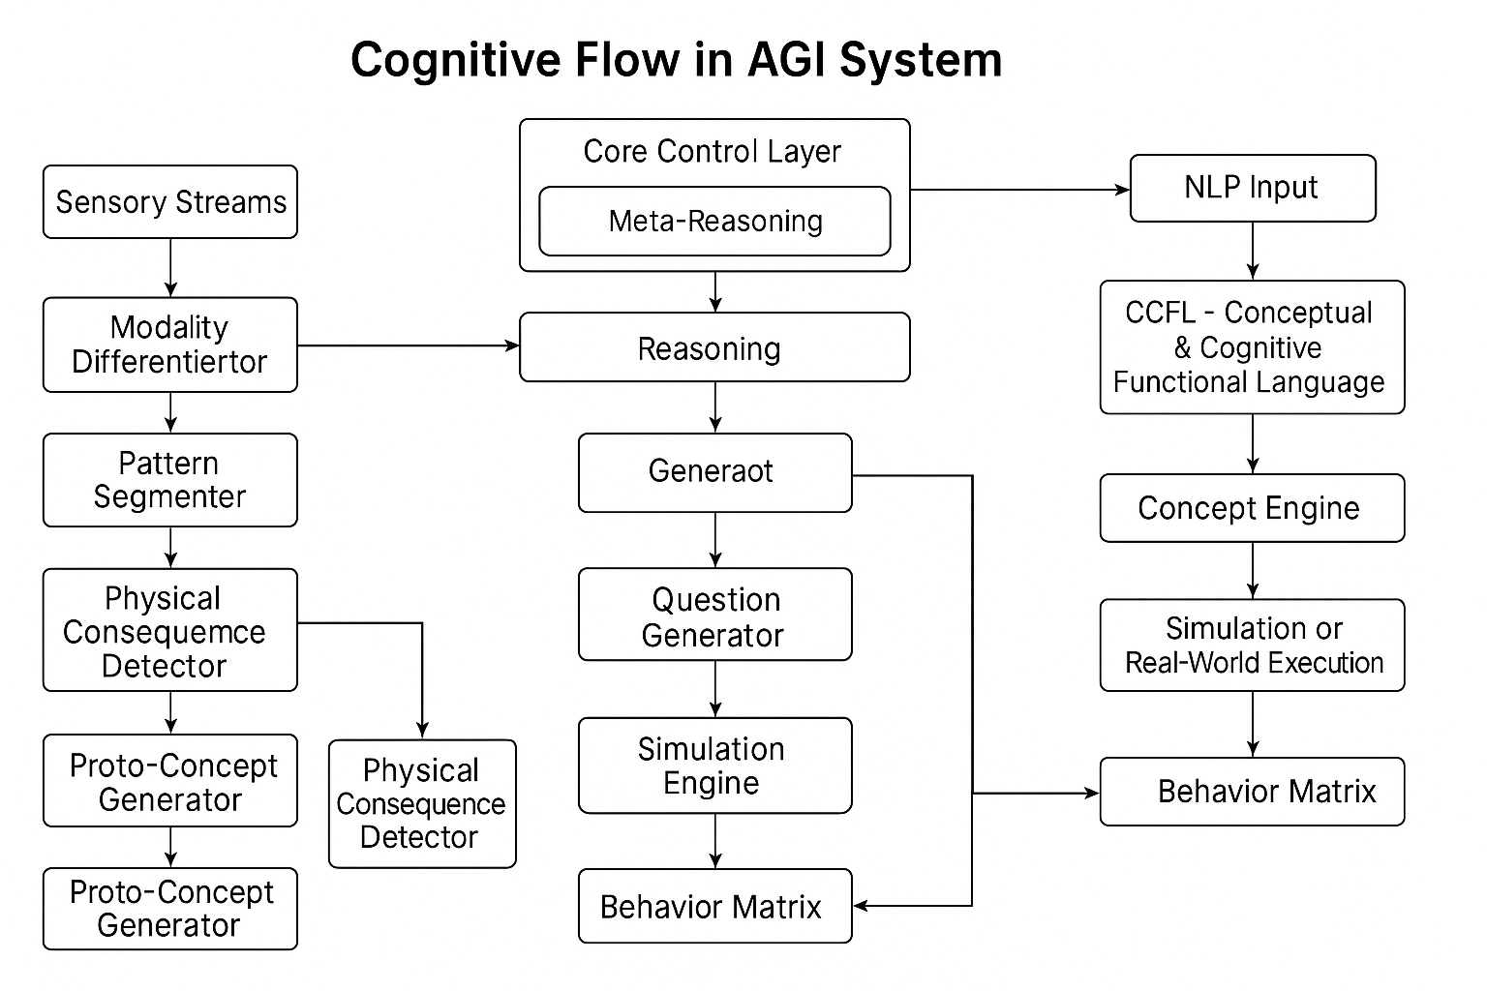
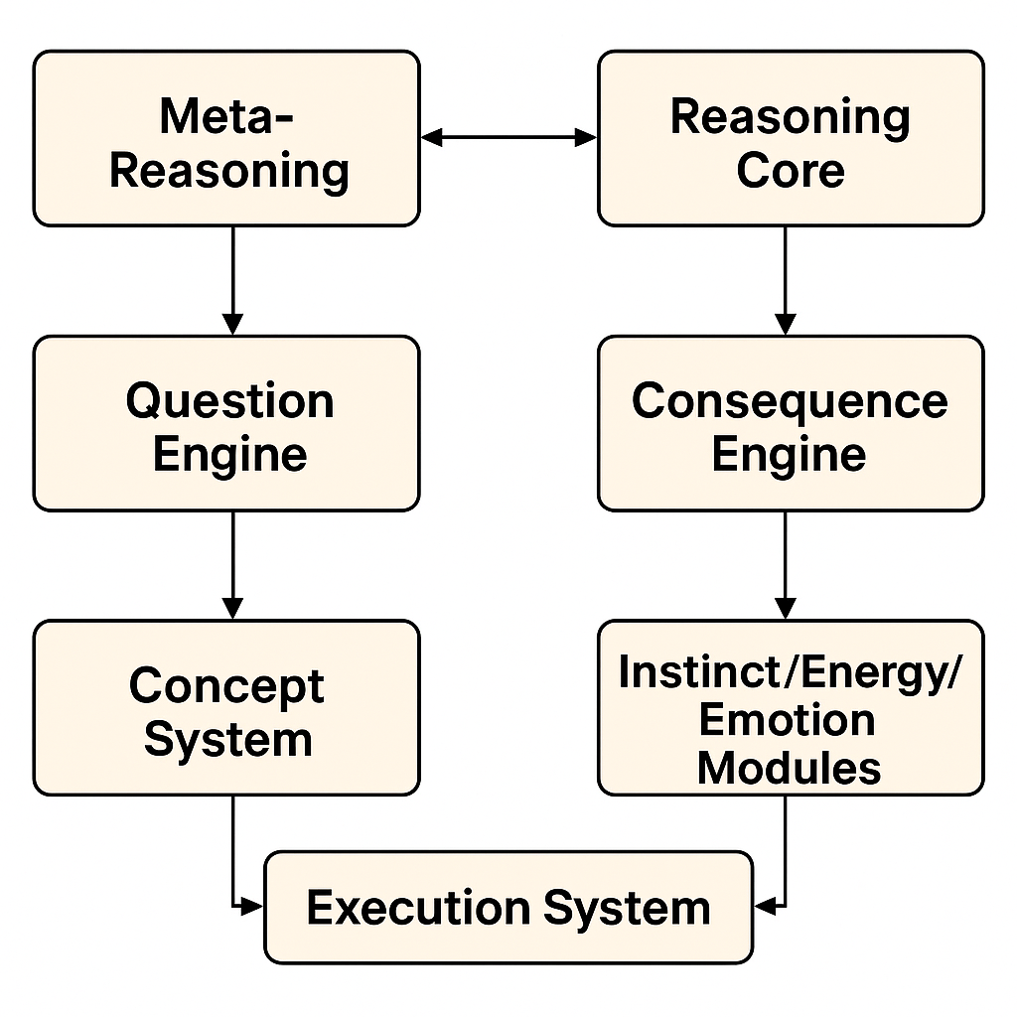

Slide 15
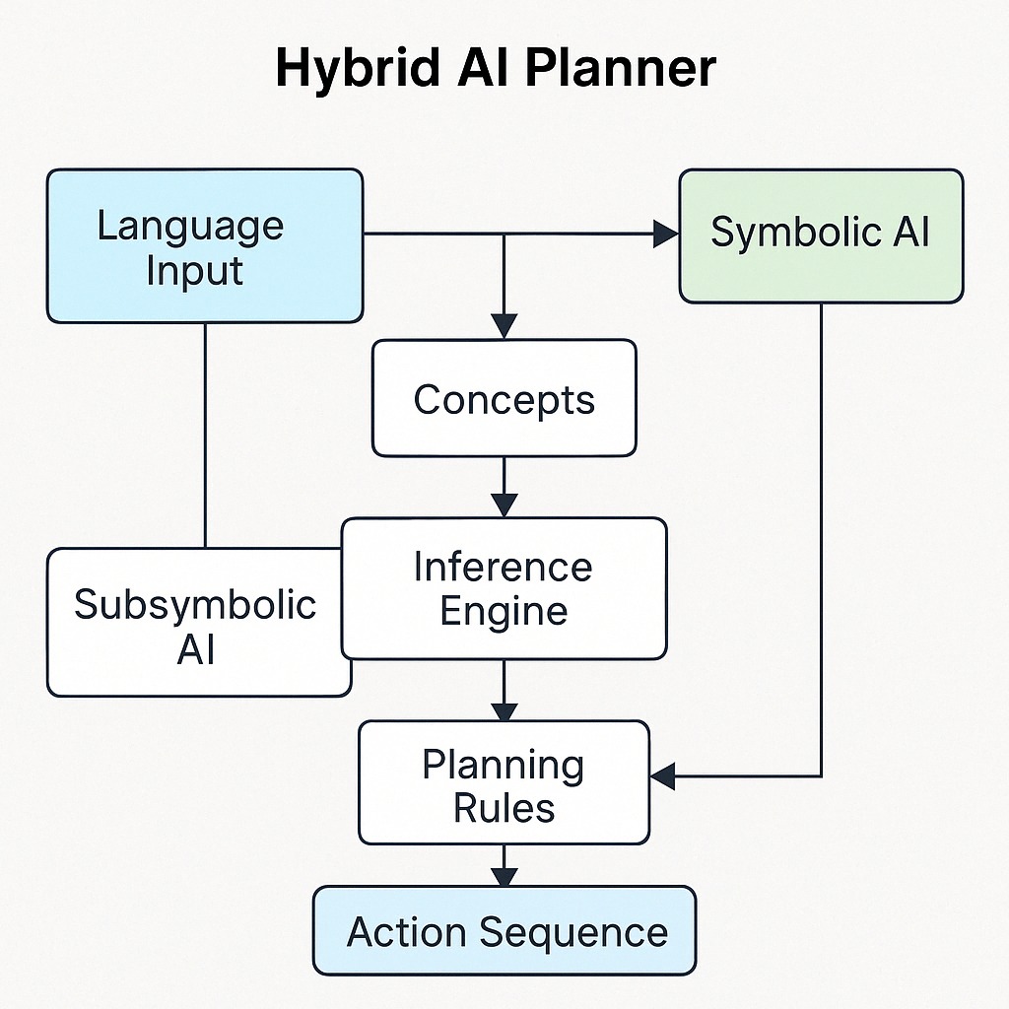
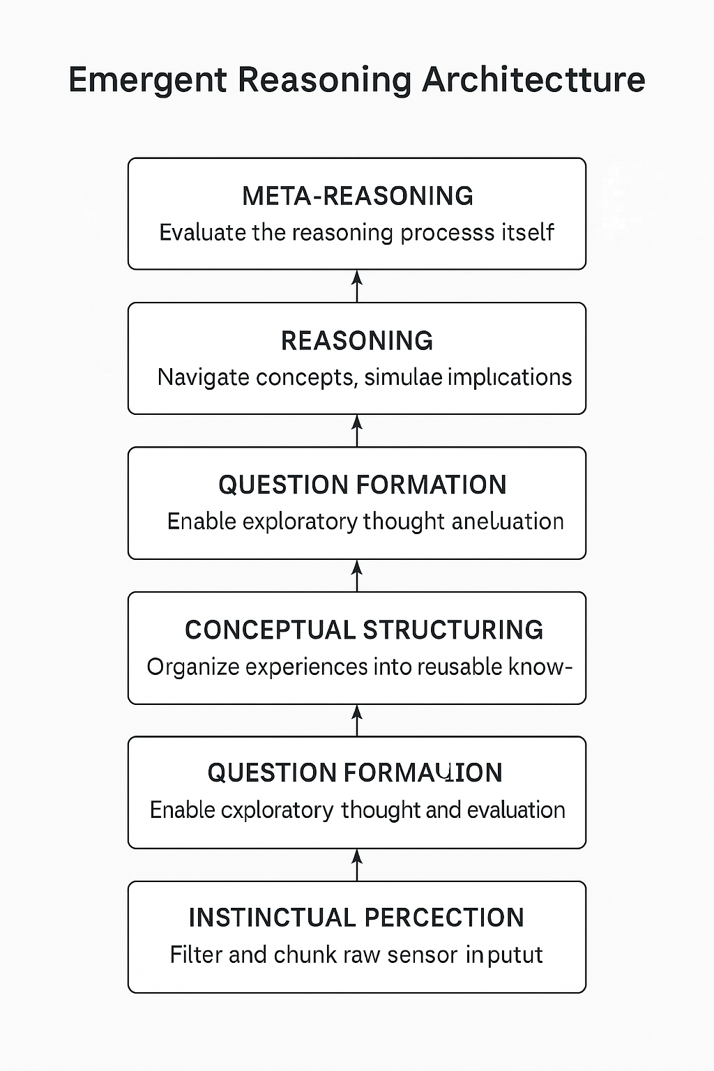

Slide 16
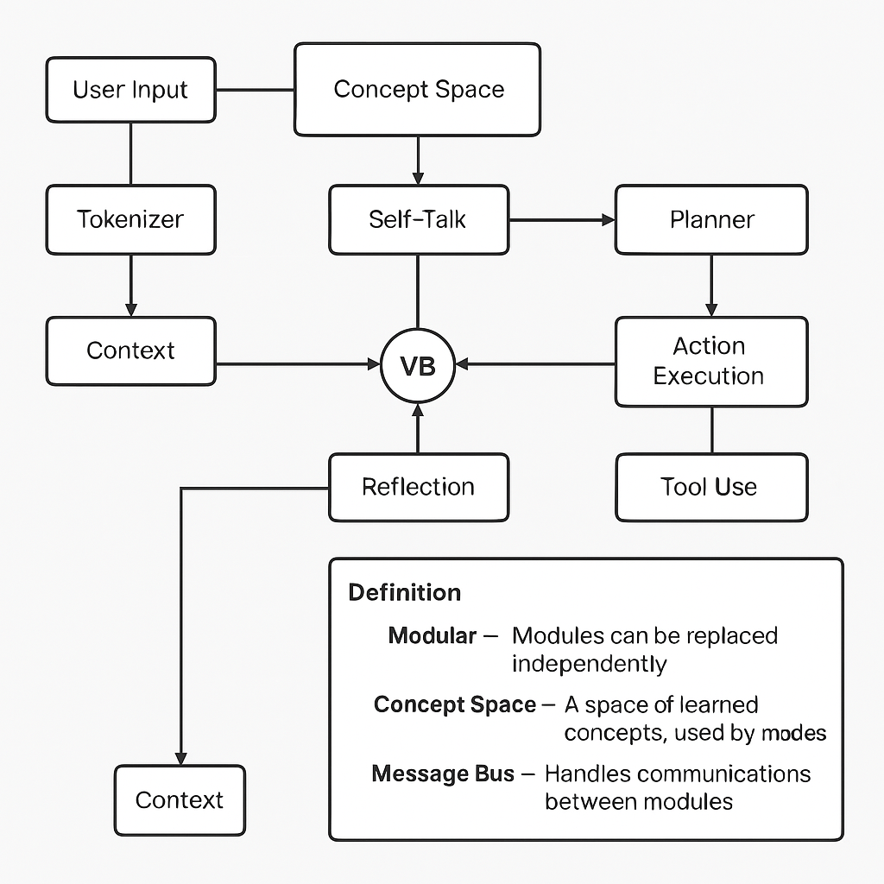

Slide 17
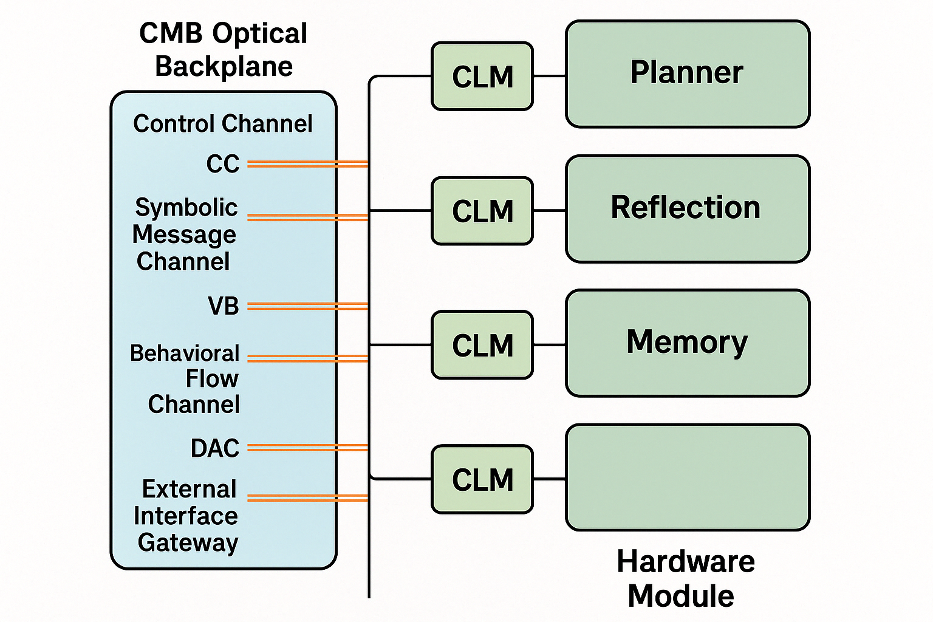
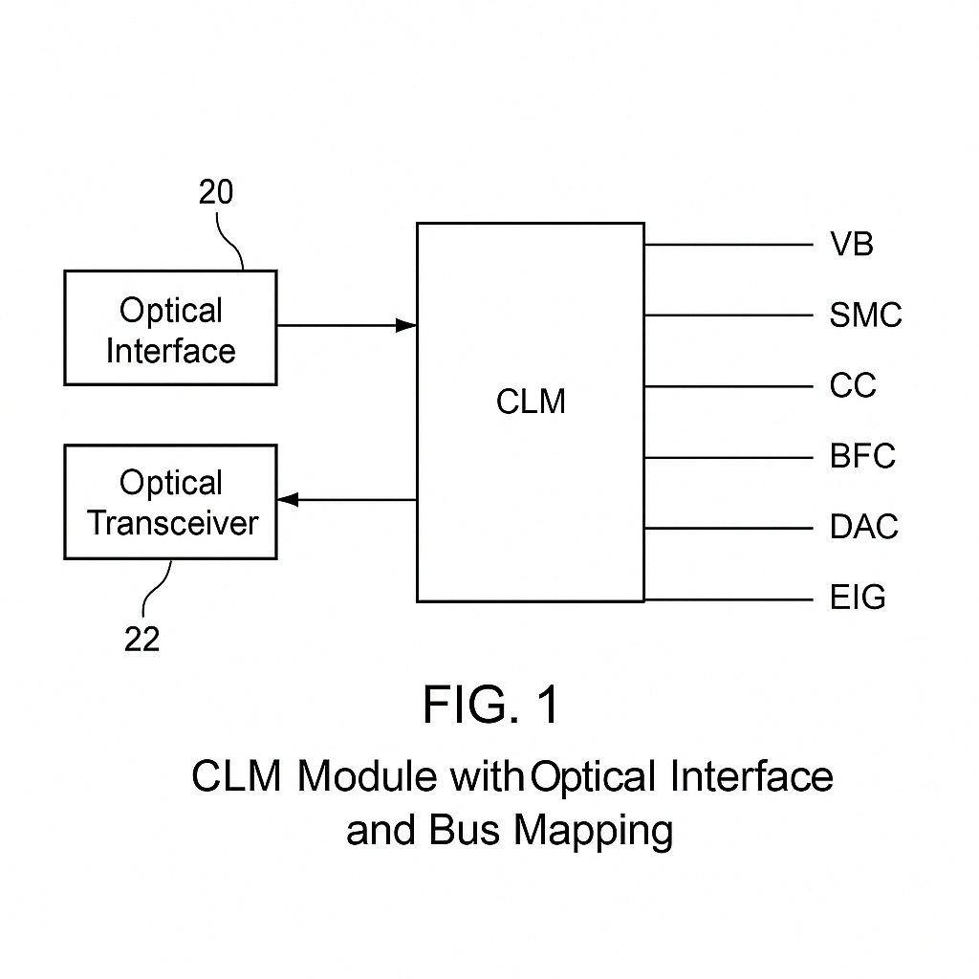

Slide 18
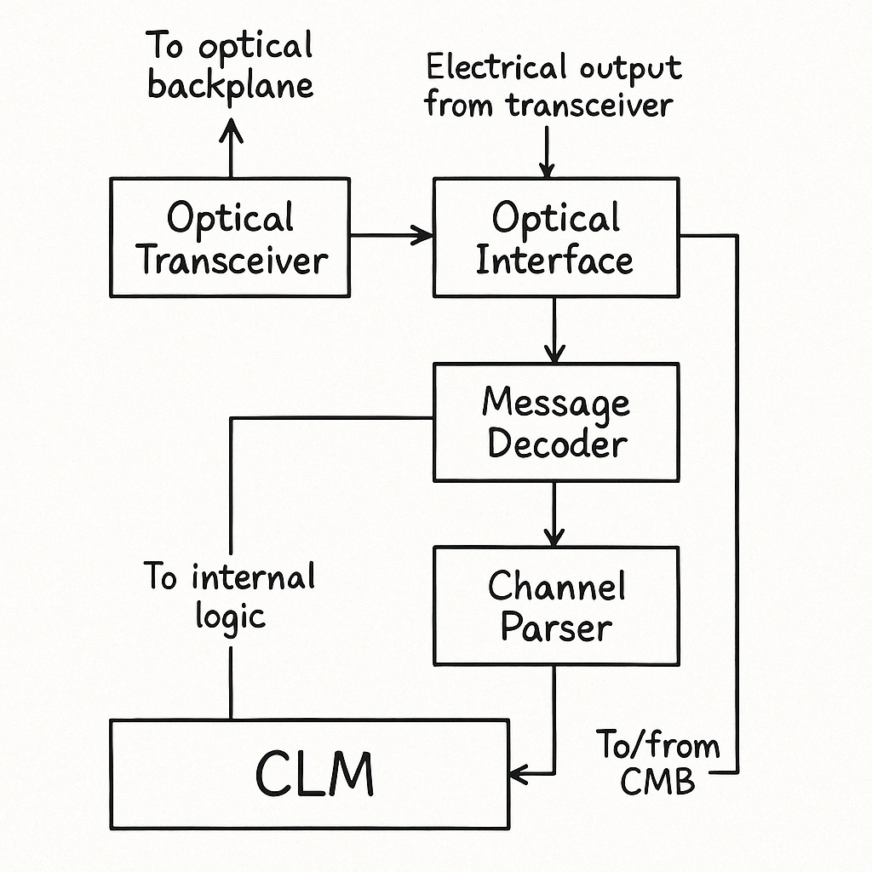
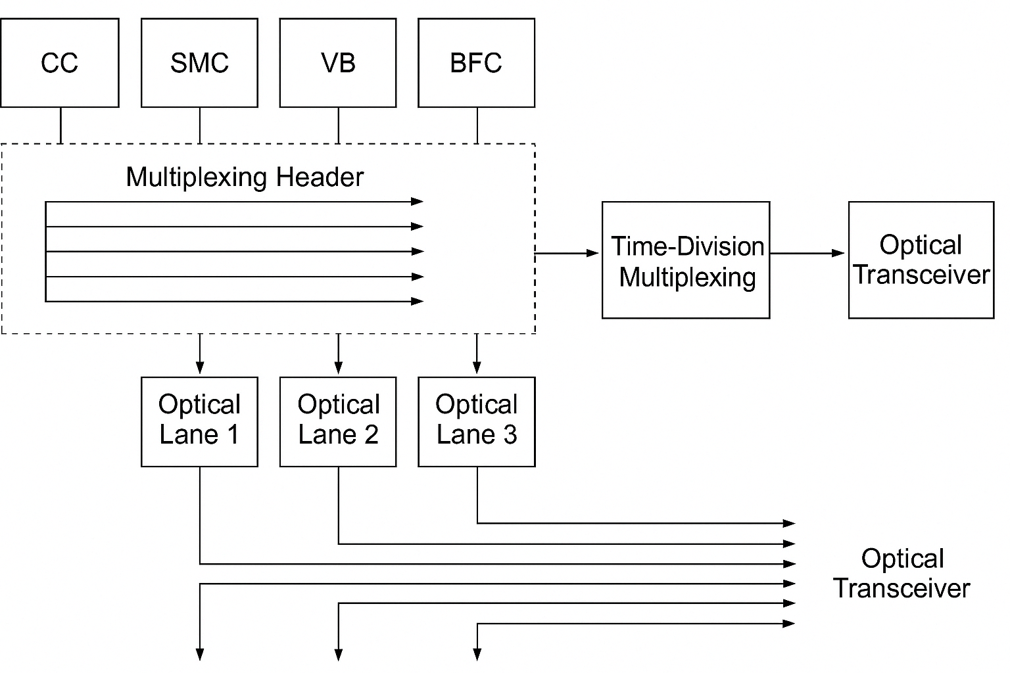

Slide 19
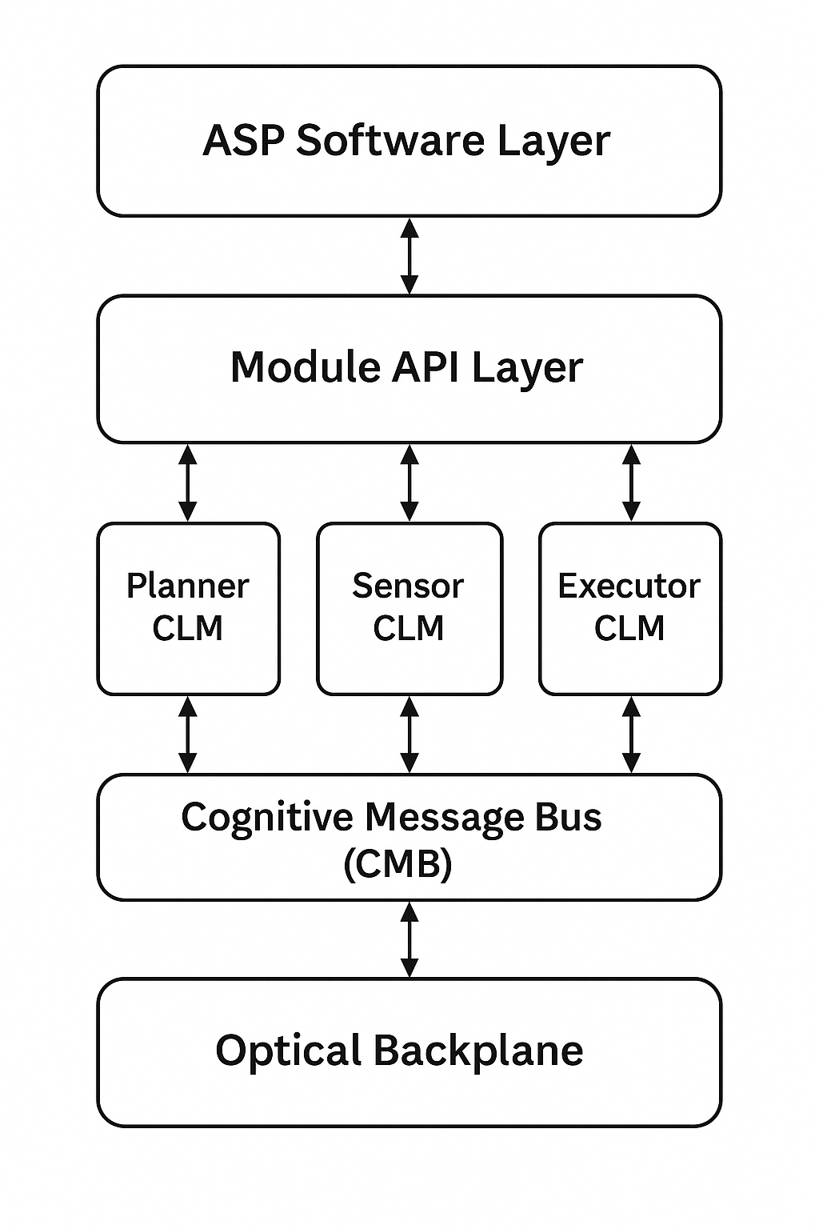
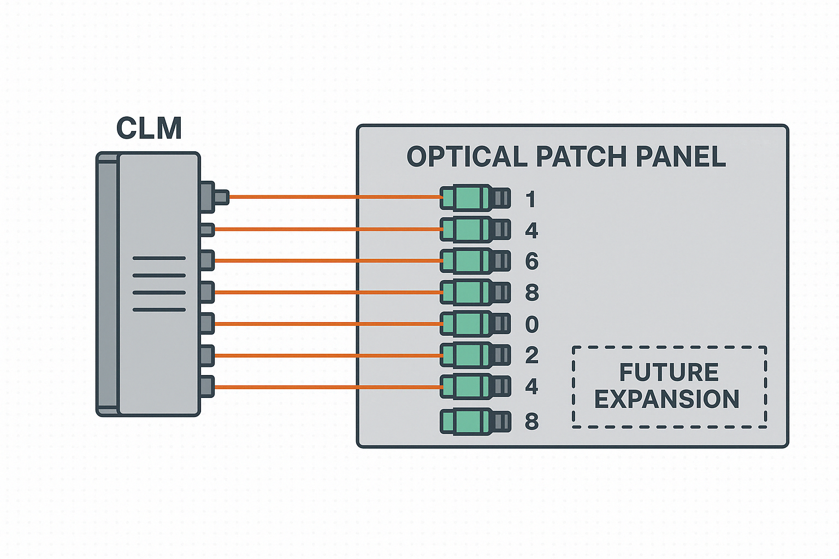
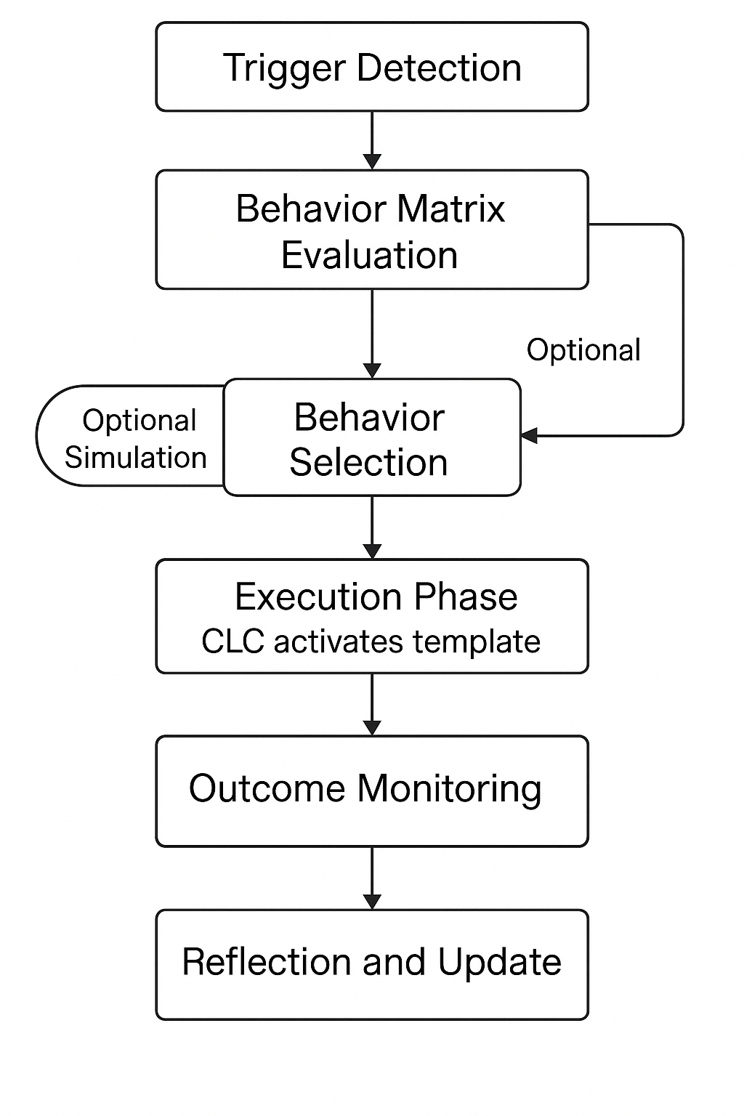

Slide 20
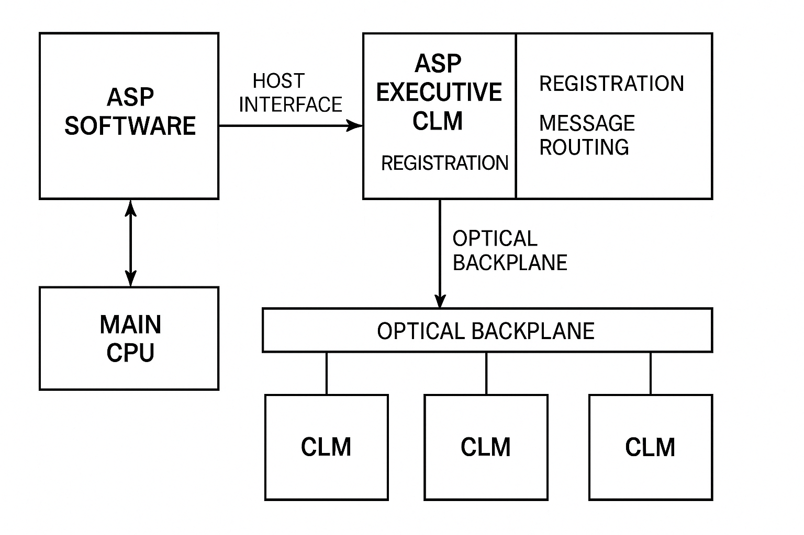
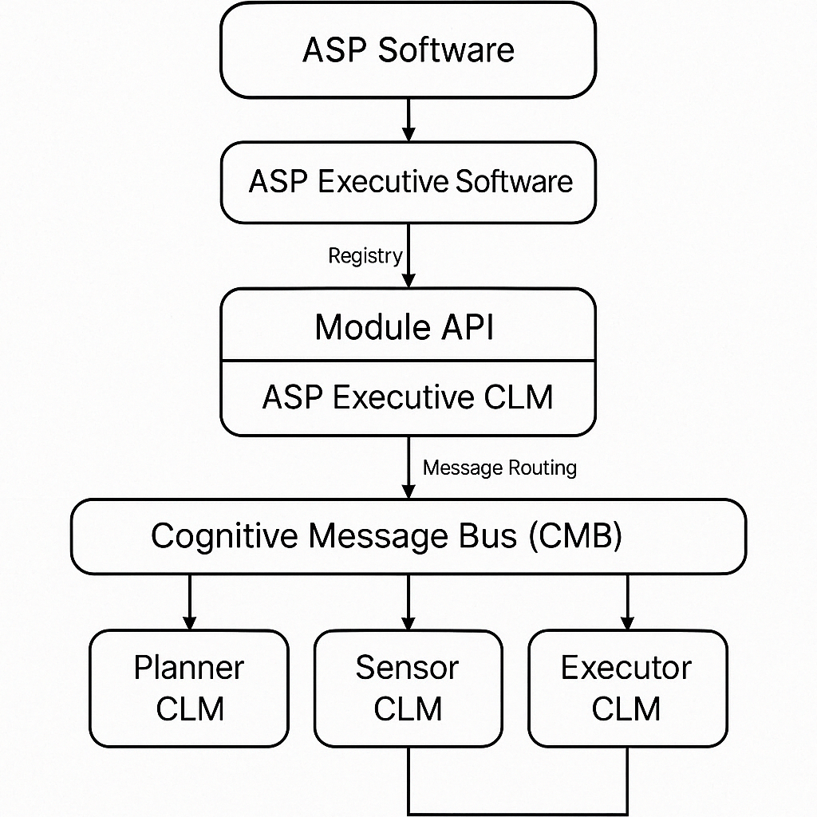

Slide 21
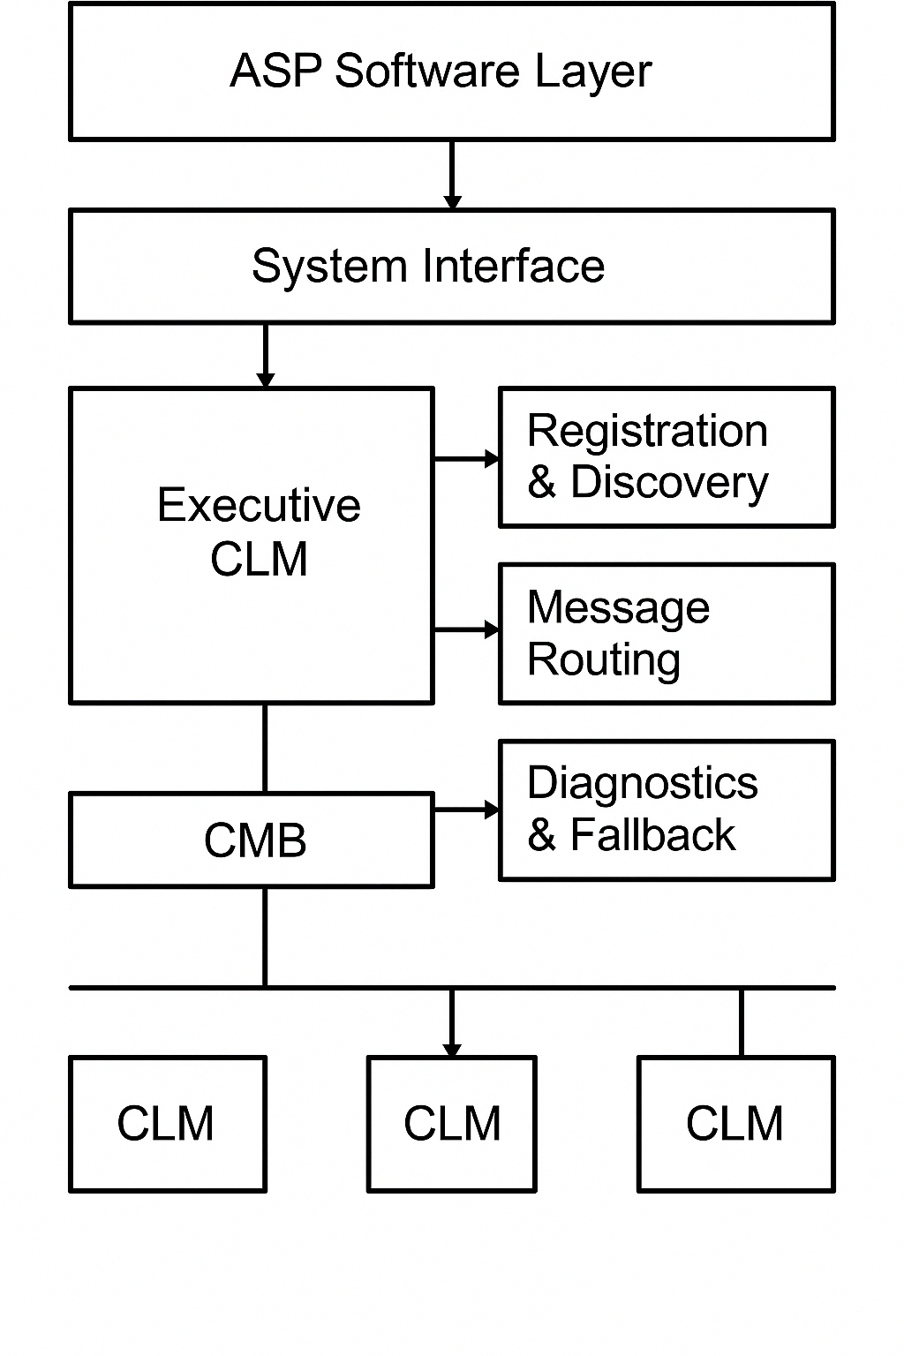
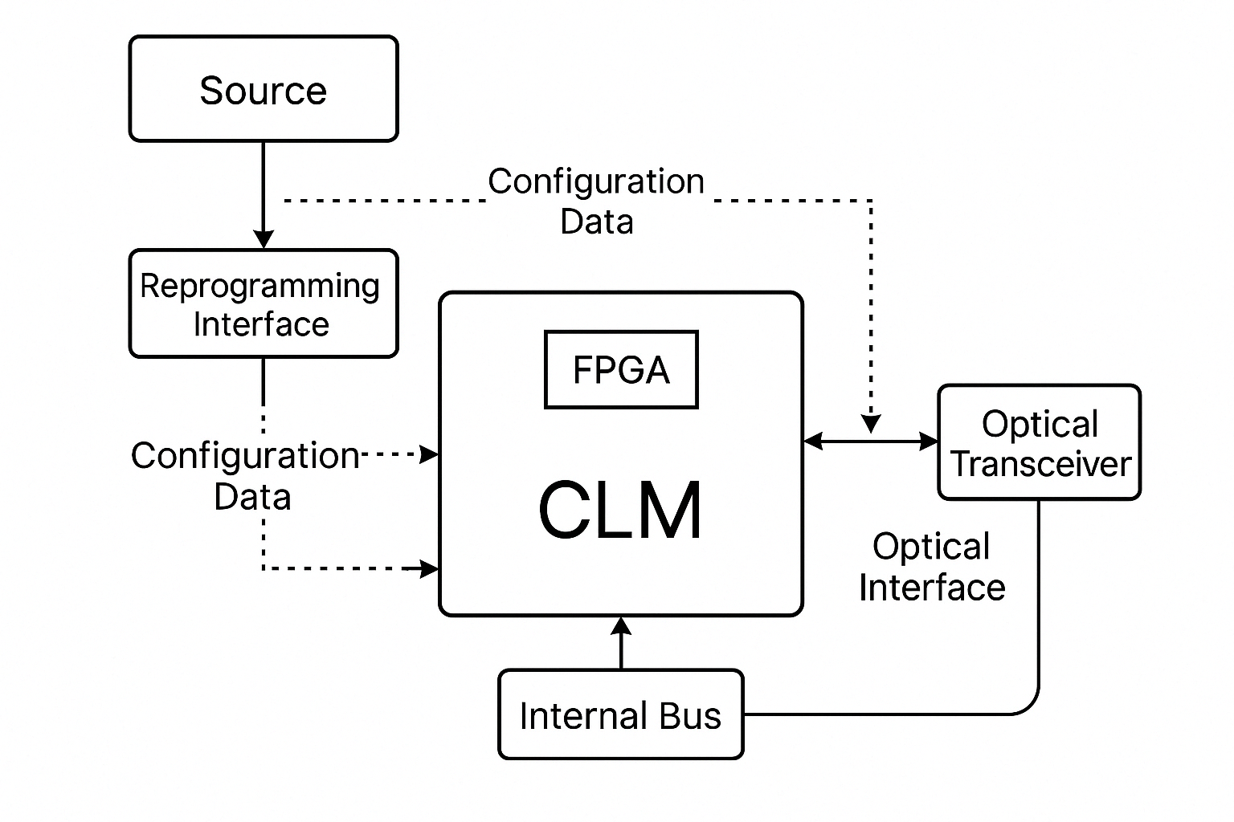
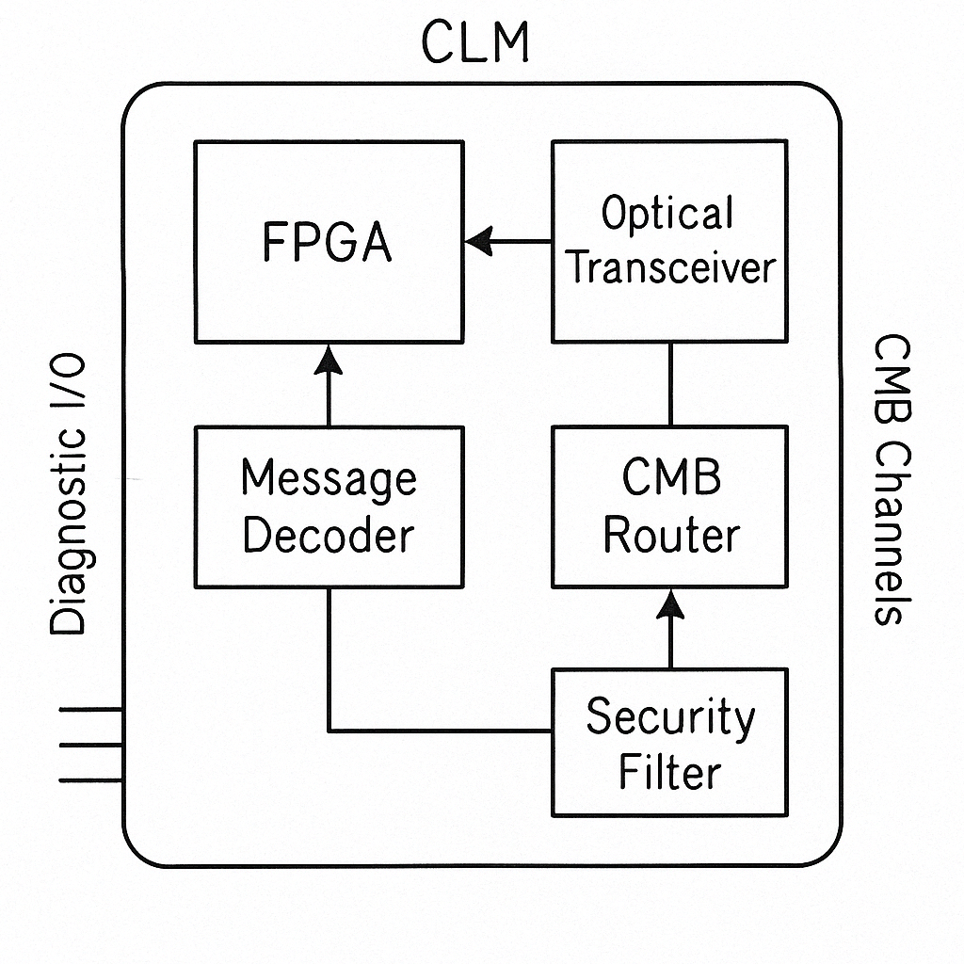

Slide 22
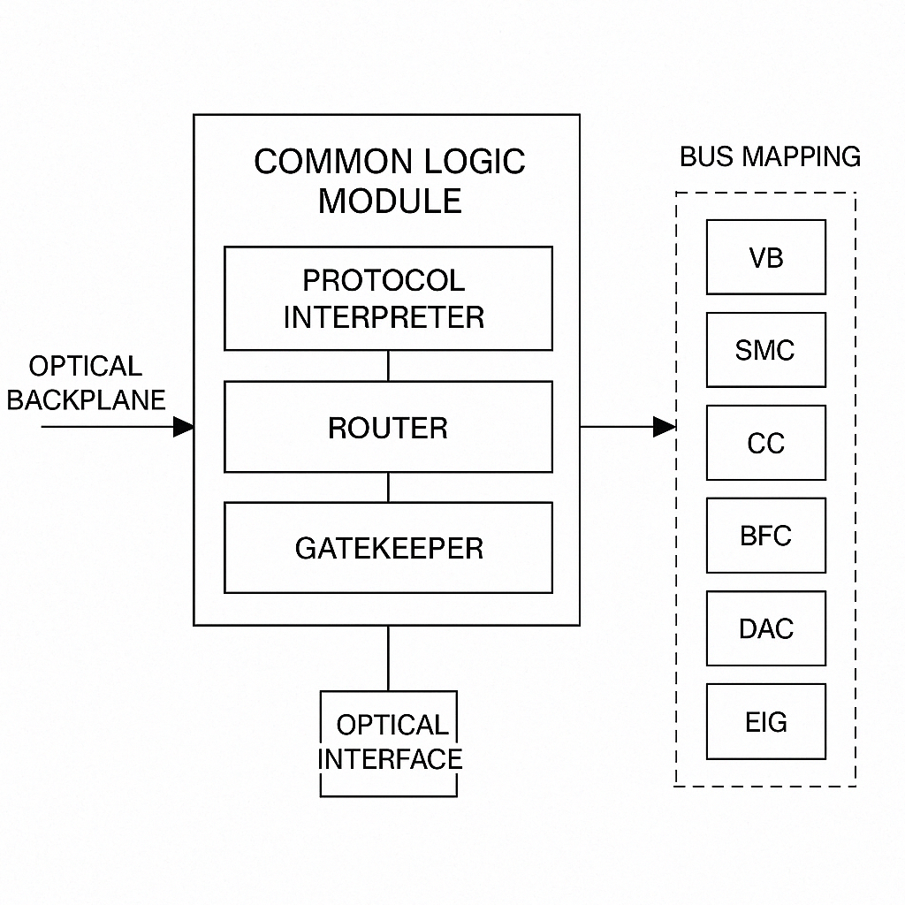
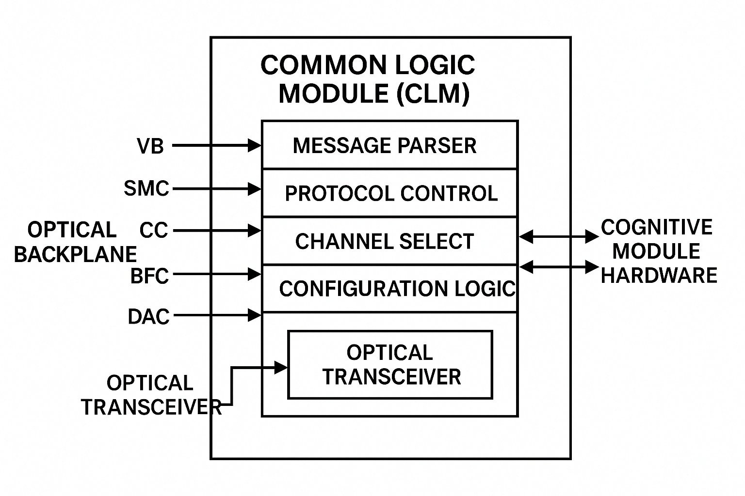

Slide 23
